Slide 1
`

Slide 2
About us
Scarborough TEC is a further and higher education college located in Scarborough, North Yorkshire. We are supported by a larger college group, the TEC Partnership.
Scarborough TEC includes dedicated facilities for the teaching of Construction, Engineering, Catering & Hospitality, Childcare, Health & Social Care, Creative and Performing Arts, Business, Computing, Games Design, Hairdressing, Beauty Therapy, Media Make-Up and many other technical and professional areas.
Scarborough TEC also offers a wide range of apprenticeships and work-based training.
Notes:
.

Slide 3
Entry requirements
Level 1 – Would require GCSE grades 1/2 or equivalent including Foundation Awards or Entry Certificates.
Level 2 – You will require 3 GCSES grade 2 or above including Maths or English or a L1 qualification in related subject.
Level 3 – You will require 4 GCSES grade 4 or above including Maths and English
There is the option to resit Maths and English if you don’t achieve the grades at GCSE.

Slide 4
What does STEC offer?

Slide 5
What is a BTEC?
BTEC’s are an alternative option to A-Levels.
Although they are often compared against A-Levels, there are varying levels of BTECs.
Here’s the breakdown:
Levels 1-2 - GCSE equivalent
Level 3 BTECs – A-Level equivalent
Levels 4-7 - Degree equivalent

Slide 6
What is an A Level?
A-Levels are subject-based qualifications taken in sixth form or colleges by students in England, Wales and Northern Ireland.
A-Levels take two years and can lead onto further study at university, apprenticeships, training or work.

Slide 7
What is a T Level?
T Levels are new two-year courses equivalent to three levels.
T Levels are based on the same standards as apprenticeships, designed by employers, and will offer around 1,800 hours of study over two years. This will include a 45-day work placement, so T Levels will be more suited to students who know what occupation or industry they want to move into.

Slide 8
So Much Choice…
Hairdressing
Animal Care
Plumbing
Art & Design
Performing Arts
Catering & Hospitality
Brickwork
Music
Electrical Installation
Crime and Society Academy
Games Design
Computing
Beauty Therapy
Policing & Uniform Services
Early Years
Construction
Business
Access to HE
Engineering
Carpentry & Joinery
Automotive
Health & Social Care
Sport
Media Make-Up

Slide 9
Apprenticeships What are They?
A job with training, for at least 30 hours per week
They can last from 12 months to 4 years depending on sector
Gain on the job knowledge & skills
Earn a wage while working toward a nationally recognized qualification
Great progression opportunities
Available to anyone 16 or over

Slide 10
Apprenticeships
Available at Scarborough TEC
Engineering
Electrical
Bricklaying
Automotive
Hospitality and Catering
Business Administration

Slide 11
The transition from School to College
Social, Academic and Personal
Social – You may not necessarily be with the same friends. You will meet new people, you will be treated and expected to act as an adult.
Academic – Choose what you want to study, remembering there will be a whole range of new courses. Independent learning will become important as there will not be a full time table
Personal – You will have more responsibility, the learning styles will be different and you will make your own decisions

Slide 12
How to Decide
A Sixth Form | Vs | A College
Days structured around a timetable, similar to a school day |  | Students treated as young adults and given more responsibility for themselves and their studies
Surrounded by students aged 16-18 |  | Surrounded by students 16+
Full timetable |  | 3/4 Days a week timetable
Study 3 subjects |  | Study 1 Core Subject

Slide 13
Life at TEC
Image – Hair and Beauty Salon Nineteen09 Restaurant Waves refectory Competitions/Fundraisers Performances & exhibitions

Slide 14
Support at Scarborough TEC
16-19 Bursary Scheme to help with your studies
16-19 Discretionary Student Support Fund
Childcare support is available, if required
Careers Advice
Success Coaches
Learning Support Practitioners
Well Being in Mind Team – NHS
Notes:
We have Success Coaches for students, supporting them to develop both their Social and their Employability skills within the college.
We also have LSP’s, these are staff who provide Targeted Support to students with special educational needs based on what you the student needs. Both in the classroom and working alongside our Success Coaches and Programme Leaders.

Slide 15
Support for Students
In class support – 1:1 or shared
Support in social times for higher needs students.
Study skills drop-in sessions – for students needing extra guidance.
Support plans written using EHCPs.
Assessments - exam concessions and screenings for dyslexia.

Slide 16
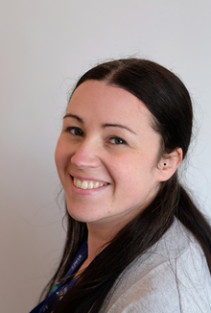
Meet the Team
Student Support Manager – Ashleigh Raw
I manage the learning support team, success coaches, enrichment and bursaries.
I have worked in education for over 10 years in secondary and further education in support roles.
I am Safeguarding Lead for the college

Slide 17
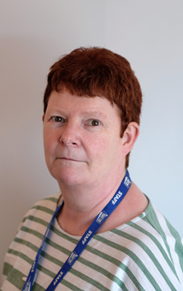
Meet the Team
Hilary Jellie – Lead Learning Support Practitioner
Manages the Learning Support Practitioners and allocates support to EHCP students.
Facilitates EHCP reviews.
Liaises with young people and schools for transition visits.

Slide 18
Meet the Team
Leigh Todd – Inclusion Assessor
Assesses exam concessions.
Facilitates EHCP reviews.
Screening for Dyslexia
Writes support plans for students.

Slide 19
Meet the Team
Nicci Sedman – Student Support Advisor
Finance support - bursary support for travel, meals, kit, uniform and childcare costs.
Transport - support with bus passes and advice.
Enrichment - organises events and activities to enrich the students' journey in college.

Slide 20
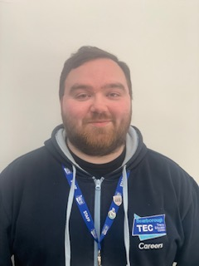
Meet the Team
Daniel Gyte – Careers Advisor
Help students understand the world of work and the skills and qualifications they need to achieve their career goals.
Help with students that are looking to apply to University, supporting them with applying for courses and student finance.
Students can book appointments, email or drop into the careers office at any time to ask questions or chat about their plans for the future.

Slide 21
Open Events at Scarborough TEC
Wednesday 29th March 5pm-7pm
Scarborough TEC, Filey Road, Scarborough, YO11 3AZ

Slide 22
Contact info
Support@scarboroughtec.ac.uk
Bursary@scarboroughtec.ac.uk
Enquiries@scarboroughtec.ac.uk
Admissions@scarboroughtec.ac.uk
Phone – 01723 372105
To apply please scan the QR code to start your application

